Slide 1
Interoperability Specifiation
IHO S-100 WG TSM5
19-21 September 2017
Eivind Mong, Raphael Malyankar

Slide 2
Background - Overview
Funded by NOAA and KHOA
S-100 Product Interoperability Analysis (IIC and Jeppesen), presented at TSM4.
Draft Interoperability Catalogue phase 1 (IIC and Jeppesen/C-MAP), presented at TSM4.
Draft Interoperability Catalogue phase 2 (IIC and Raphael/Eivind), presented at S-100WG2.
Draft Interoperability Specification – Portolan Sciences

Slide 3
Background - S-100 Product Interoperability Analysis
Built on input from hydrographic offices and ECDIS OEMs, which resulted in list of approximately 70 requirements.
Provided an overview of issues arising when different S-100 data products are in simultaneous use on the same screen (ECDIS).
Aim was to define the different aspects of interoperation of S-100 based products, and thereby provided a basis for designing a solution.
Included example usage scenarios for the combined use of data products that were utilized to validate the architecture of the Interoperability Catalogue data model.

Slide 4
Background - Draft Interoperability Catalogue
Phase 1
Used the example scenarios from the Interoperability Analysis to draft the principles and constraints upon which the solution is based.
Included first draft of the data model.
Described the paradigm of the Interoperability Catalogue. Paradigm includes things like;
The ENC is part of a data ecosystem;
There will only be one official Interoperability Catalogue;
Who will own and issue the Interoperability Catalogue;
Catalogue maintenance, substitutability, extensibility and customizations;
Support for different levels of interoperation;
Defined 5 levels of interoperabilty;
Processing model;
And elements of user control.

Slide 5
Background - Draft Interoperability Catalogue
Phase 1
Level 0 – Overlays – no explicit interoperability
Interoperability catalogues are not used. ENC is treated as the main product on the screen, and all other products are overlays. Information layer priority continues to conform to the relevant IMO and IEC performance standards.
Data product overlays may be portrayed using transparency so as not to obscure lower layers, but transparency values are generally not adjusted using rules based on data content or feature types. They may be adjusted using context information such as the number of stacked layers or light level mode.
Level 0 interoperability is effectively equivalent to what systems do today.
Note: There is an implicit assumption here that portrayal catalogues assign features to only over/under-radar display planes. If display planes are given more complex semantics and continue to be defined in portrayal catalogues, Level 0 is likely to merge into Level 1.

Slide 6
Background - Draft Interoperability Catalogue
Phase 1
Level 1 – Interleaving
The ENC is still treated as the main product, but feature layers from other products may be interleaved with ENC feature layers to prevent ENC data from being obscured. There is no other interoperability-related processing of feature data at this level.

Slide 7
Background - Draft Interoperability Catalogue
Phase 1
Level 2 – Type-based selectivity and feature class replacement
The ENC is still treated as the main product, but feature types in other products may be determined to be superior to specific ENC feature types, in the sense that the features in the other product contain more details, have higher-resolution data values, etc., than the equivalent features in the ENC. In this level of interoperability, global suppression of equivalent ENC features in favor of the superior layer is allowed – all instances of the specified ENC feature type are suppressed and the superior feature layer is displayed.
Selection of replaced and replacement features in this level uses only feature type (and data product) information. Attribute values are not considered. Further, the only operation is replacement of instances as a whole, no combination of replaced and replacement information is done.

Slide 8
Background - Draft Interoperability Catalogue
Phase 1
Level 3 – Attribute value-based selectivity and feature hybridization
The ENC is treated as one of the components of the data stack, and selected feature instances from other products may be treated as being superior to or enhancing selected ENC feature instances. The feature instances are selected using selector expressions that use feature type and values of thematic attributes. The geometry of the superior/enhancing feature instance must be spatially equal to that of the ENC feature instance (within specified tolerances).
The interoperability result is that the ENC feature instance is either suppressed or replaced by the other feature instance or hybridized with it (i.e., their attributes are combined in some way). In Level 3, only thematic attributes can be combined.
Hybridization may consist of adjustments to attributes of one of the ENC/other feature instances, such as re-calculation of values of numeric attribute, addition of listed values to an enumeration attribute. Hybridization may also result in an instance of a different feature type with an enhanced set of thematic attributes, some of which may be new attributes generated from attribute values of the original instances.
The interoperability product will include a hybrid feature catalogue and portrayal catalogue defining the feature types and portrayals for new hybrid features. Their structures will be the same as regular feature and portrayal catalogues.

Slide 9
Background - Draft Interoperability Catalogue
Phase 1
Level 4 – Spatial operations
This level is the same as Level 3, but permitted spatial queries (to determine related subsets) and operations (to define the interoperation result) are explicitly defined using an adequate set of spatially-capable rules.
This means that the ENC and other-product feature(s) need not be spatially equal, they need only be related to one another by the spatial query. For hybridization, in addition to thematic attributes, feature geometry can also be combined using spatial operations.
Note: The spatial queries for determining related ENC/other-product features can be defined in terms of explicit rules such as positions within X m, or X mm at product scale for point features, 99% overlap for area features, or some other adequate explicit rule.

Slide 10
Background - Draft Interoperability Catalogue
Phase 1
First version of the processing model.

Slide 11
Background - Draft Interoperability Catalogue
Phase 1
Subsequent changes came mainly in this area

Slide 12
Background - Draft Interoperability Catalogue
Phase 1
Outcomes of presentation of phase 1 draft was;
Allow pre-processing and post-processing of the interoperability catalogue
Only levels 0/1/2 should be implemented in the first version, while levels 3/4 is something for the future. After levels 0/1/2 have been fully tested.
Some changes to the data model.

Slide 13
Background - Draft Interoperability Catalogue
Phase 2
Draft Interoperability Catalogue phase 2 (IIC and Raphael/Eivind), presented at S-100WG2.
Included the requested two phased implementation roadmap;
Implementation Phase 1 to include levels 0/1/2;
Implementation Phase 2 to include levels 3/4;
Interoperability Processing diagram now shows path for both pre and post processing.
Data model changes
Removed S100_IS_SaturationOffset class
Removed significant attribute from S100_IC_Feature
Added attributes geometryType and attributeCombination to S100_IC_Feature

Slide 14
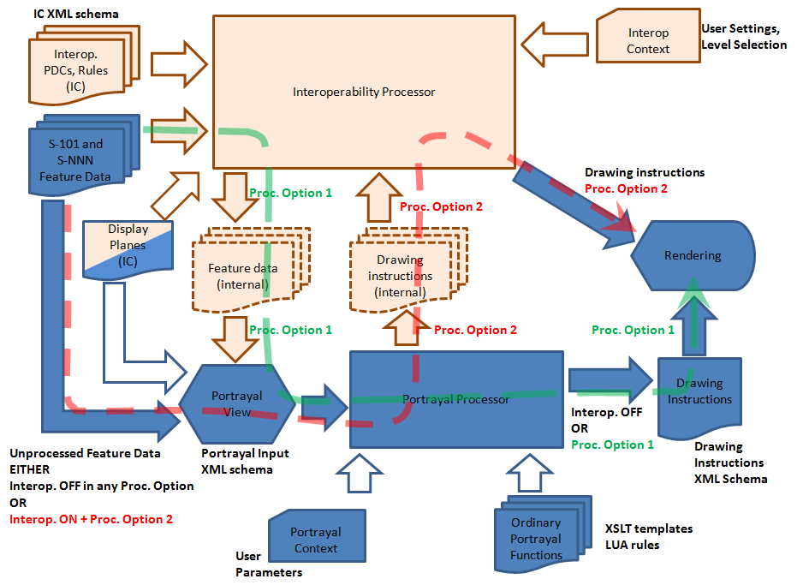
Background - Draft Interoperability Catalogue
Phase 2
Interoperability Processing diagram now shows path for both pre and post processing.
Notes:
Blue: ordinary portrayal processing; beige: interoperability processing; mixed: both interoperability and ordinary portrayal. Filled block arrows: feature data; hollow block arrows: parameters or control information. The green dashed arrow shows the processing stream when interoperability precedes portrayal processing; the red dashed arrow when interoperability follows portrayal.

Slide 15
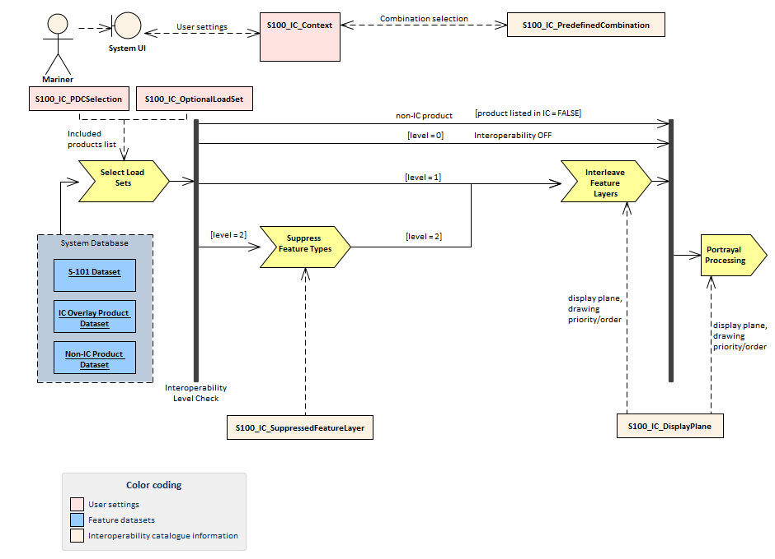
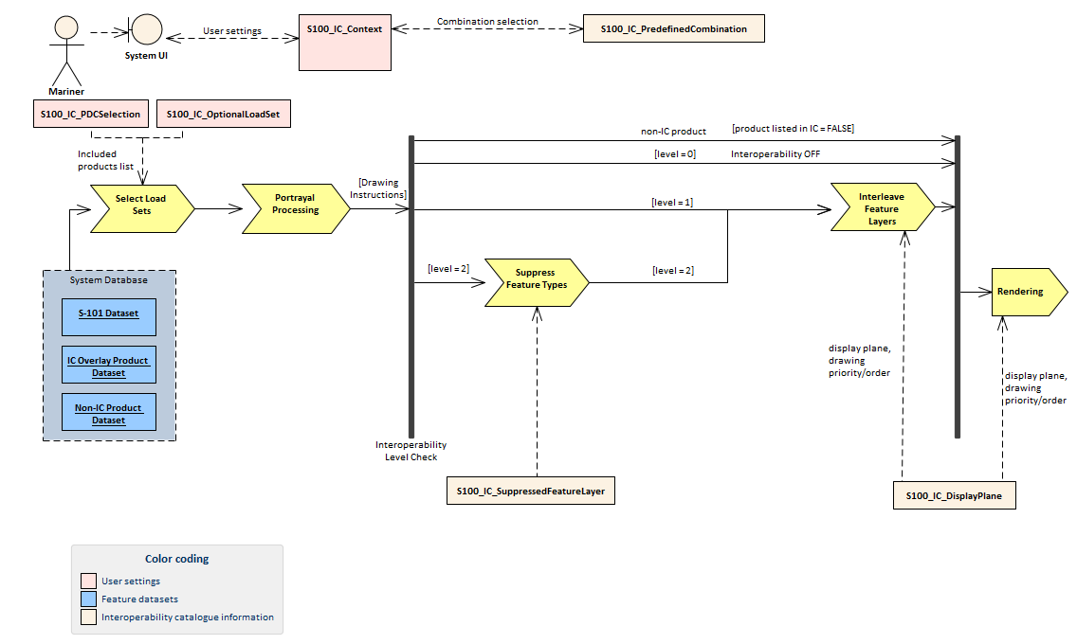
Background - Draft Interoperability Catalogue
Phase 2
Pre-processing
Post-processing

Slide 16
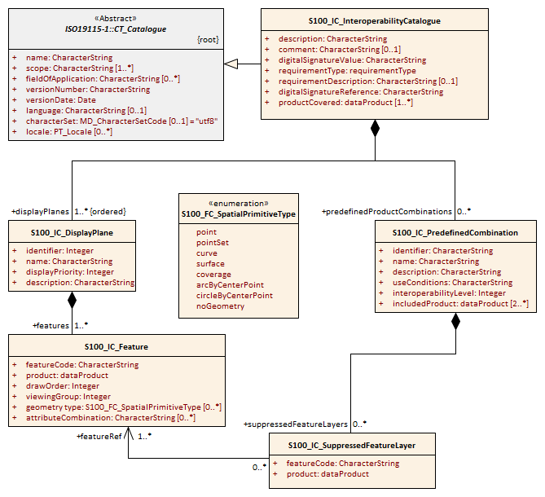
Background - Draft Interoperability Catalogue
Phase 2
Phase 1 Interoperability Catalogue implementation roadmap data model that includes only levels 1 and 2.

Slide 17
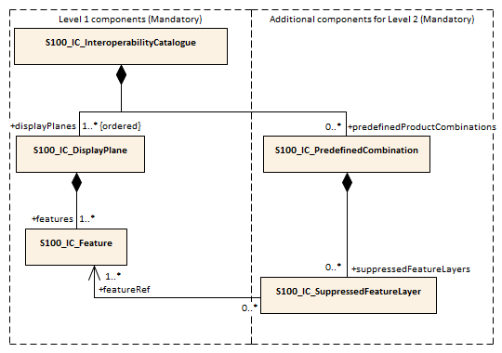
Background - Draft Interoperability Catalogue
Phase 2
Phase 1 Interoperability Catalogue implementation roadmap data model that includes only levels 1 and 2.

Slide 18
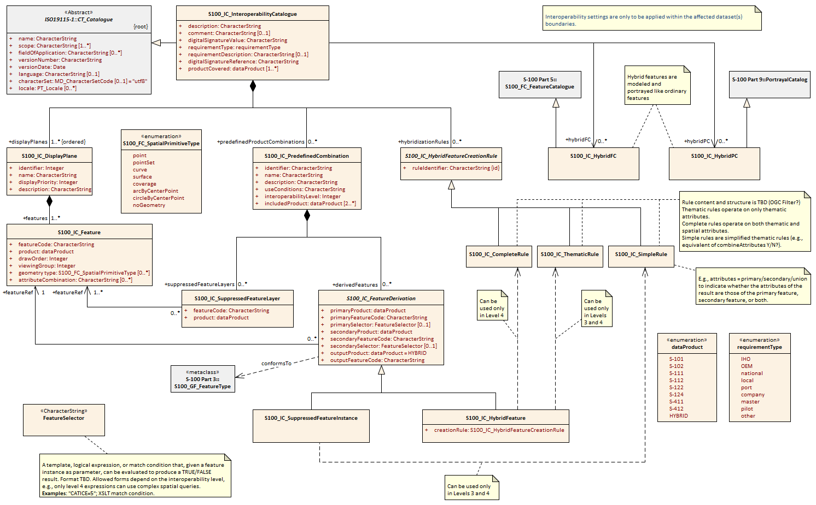
Background - Draft Interoperability Catalogue
Phase 2
Complete data model after Phase 2 development

Slide 19
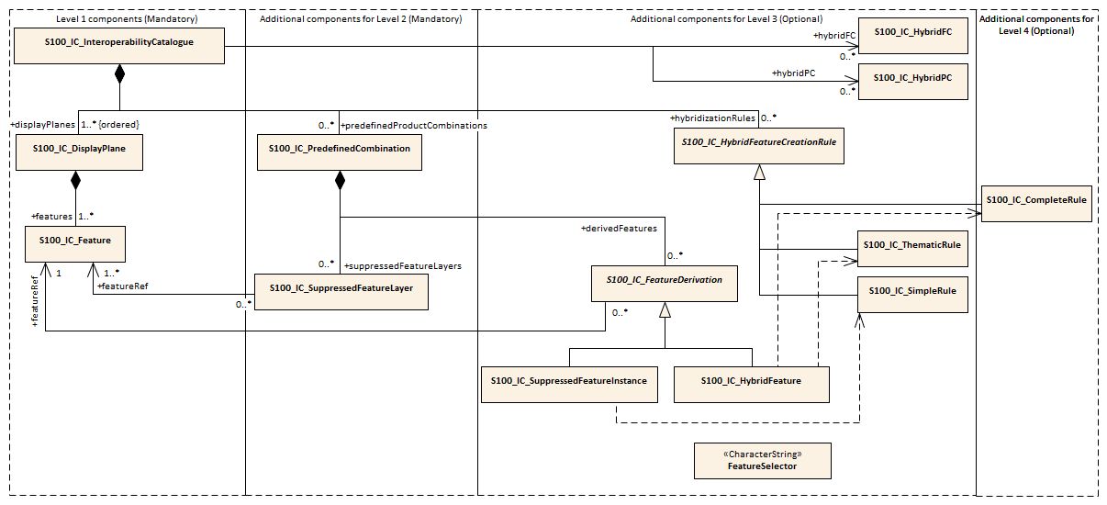
Background - Draft Interoperability Catalogue
Phase 2

Slide 20
Level progression
Level 0
Level 1
Level 2
Level 3
Level 4
No interoperability
Minimal visual integration
Overlays only
Low implementation complexity
More visual integration
Feature layer or subset suppression
Simple expressions with thematic attributes
Feature layer or subset replacement
Greater implementation complexity
Tight visual integration
Feature hybridization
Simple expressions with thematic attributes
Complex expressions with thematic attributes
Even more implementation complexity
Tight visual integration
Additional spatial objects
Complex expressions with thematic attributes
Complex spatial relations and operations
Even higher implementation complexity

Slide 21
Background - Draft Interoperability Specification
Draft Interoperability Specification – created by Raphael Malyankar and Eivind Mong, using input from the S-100 Product Interoperability Analysis and the two phases of the Interoperability Catalogue design.
Details how to create and manage an Interoperability Catalogue for levels 1 and 2, and provide some details for Levels 3 and 4.
The following S-100 based product specifications are supported; S-101, S-102, S-111, S-112, S-122, S-124, S-411 and S-412.

Slide 22
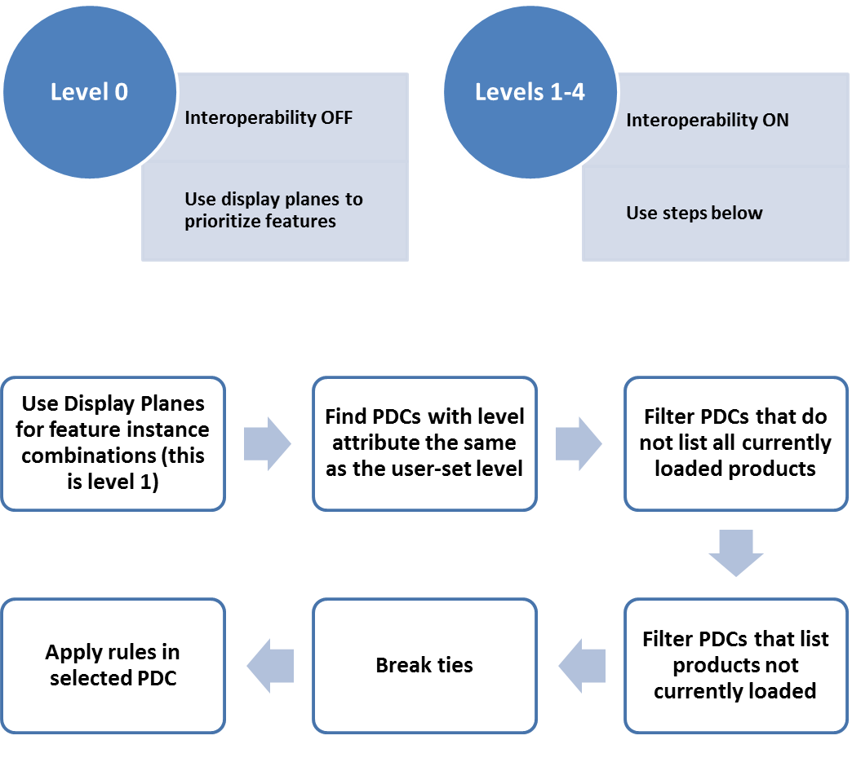
Data Content and structure
Process for selecting rules

Slide 23
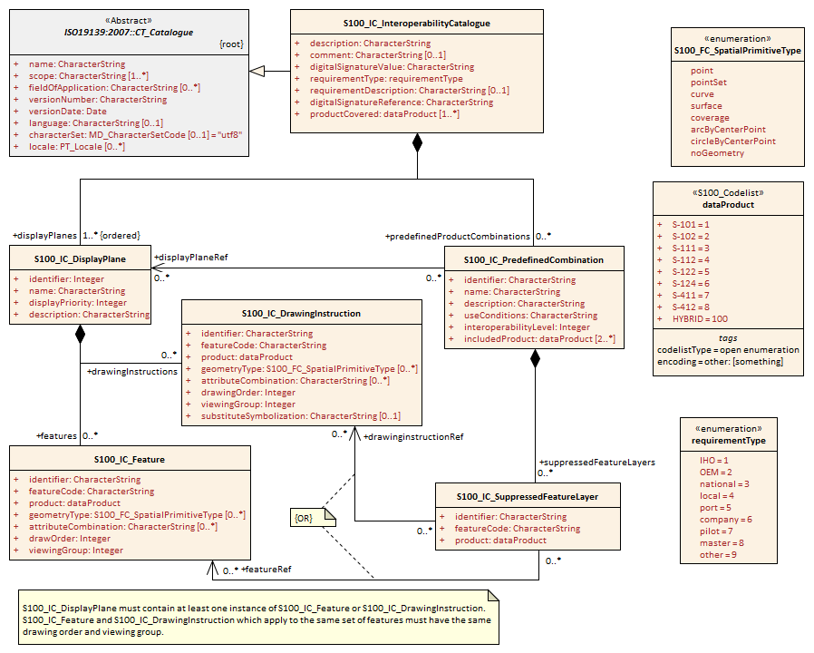
Data Content and structure
Basic interoperability catalogue (Levels 1 & 2)
Changes from Phase 2;
Added association between S100_IC_PredefinedCombination and S100_IC_DisplayPlane
S100_IC_DrawingInstruction class added.
Identifier attribute added to all classes.
Notes:
Added association between S100_IC_PredefinedCombination and S100_IC_DisplayPlane to enable predefined combinations to include display planes.
S100_IC_DrawingInstruction class added, was requested by OEMs as additional means of constructing display planes.
Identifier attribute added to all classes to enable easy referencing.

Slide 24
Data Content and structure
Interoperability Catalogue – what is it?
The Interoperability Catalogue (IC) specifies the relative display prioritization of feature types (and instances), as defined in individual product specifications, in relation to other feature types (and instances) which may be defined in any of the data products declared to be within the scope of the Interoperability Catalogue.
This is accomplished by the following classes; Display Plane, Feature type display information, Feature layer, Predefined combination, Drawing instruction

Slide 25
Data Content and structure
Class name | Class description
Display Plane (S100_IC_DisplayPlane) | A display plane element acts as a container for display information for specified feature classes. The display priority for the plane as a whole is provided in the S100_IC_DisplayPlane element. All the types within an instance of S100_IC_DisplayPlane have the same display priority (encoded in attribute displayPriority) relative to feature types in another instance of S100_IC_DisplayPlane.
Feature type display information (S100_IC_Feature) | The S100_IC_Feature element describes the display parameters for all features of a specific feature type in a specific product. The S100_IC_Feature element determines the order of drawing the feature type identified by its featureCode attribute relative to other feature types in the same display plane. It also specified the viewing group to which the feature is assigned. Optionally can be restricted to a subset of instances of the feature type by additional attributes that specify the type of spatial primitive and indicate specific values of thematic attributes.

Slide 26
Data Content and structure
Class name | Class description
Feature layer (S100_IC_SuppressedFeatureLayer) | Each instance of this element identifies a feature type in a specific data product that will be supressed within a Predefined combination, Feature type display information or Drawing instruction.
Predefined combination (S100_IC_PredefinedCombination) | A predefined combination element defines a collection of data products for which a common set of interoperability operations have been defined in the Interoperability Catalogue. Instances of predefined combinations are also characterized by interoperability level, which allows the encoding of different sets of operations depending on how tightly integrated the products are to be on the resultant display.

Slide 27
Data Content and structure
Class name | Class description
Drawing instruction (S100_IC_DrawingInstruction) | Drawing instructions in the Interoperability Catalogue specify the display order used by the rendering engine in producing the portrayal output of a given feature type/geometric primitive type/attribute value combination. It determines the order of drawing the feature type identified by its featureCode attribute relative to other feature types in the same display plane. The applicability of feature types can be further restricted by the type of spatial primitive and values of thematic attribute, using geometryType and attributeCombination attributes.
The operation of S100_IC_Feature and S100_IC_DrawingInstruction elements in interoperability catalogues is essentially the same as far as assignment of drawing order, priority, and display planes is concerned. They differ in that S100_IC_DrawingInstruction provides an optional attribute to substitute the symbolization elements of the drawing instruction.

Slide 28
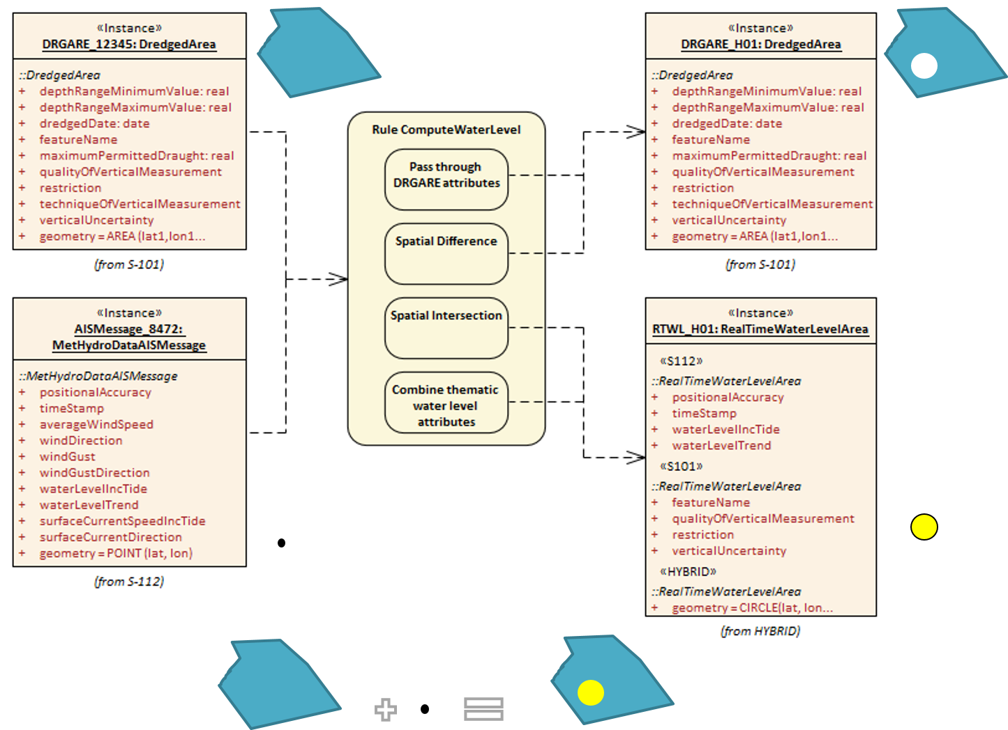
Data Content and structure
Illustrative example of the operation of a creation/replacement rule

Slide 29
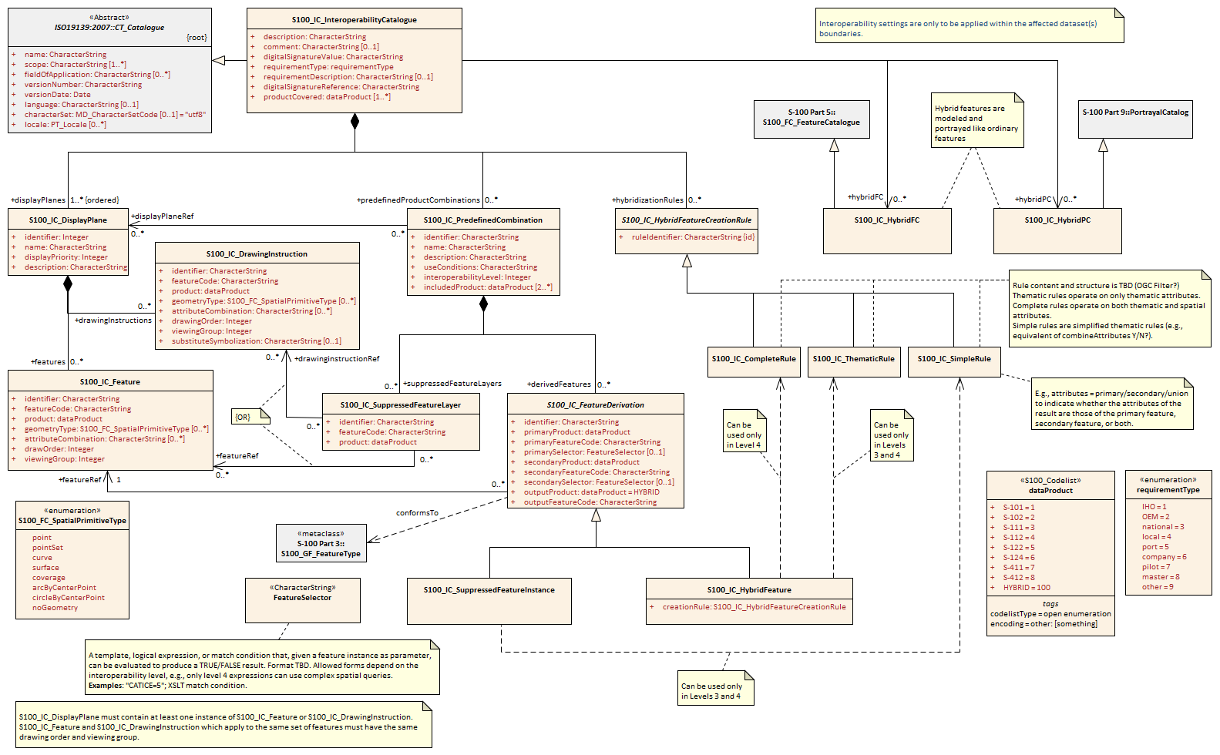
Data Content and structure
Application schema for full interoperability catalogue

Slide 30
Coordinate Reference Systems (CRS)
The interoperability catalogue does not have a CRS of its own.
Expected that the interoperability-ready product’s own CRS should be used by the viewing system to generate the portrayal.

Slide 31
Data Quality
Data quality in the individual dataset should be kept available and accessible by user selection.
Amalgamating data quality between products is outside the scope of the interoperability specification.

Slide 32
Performance Standards for ECDIS
IMO Performance Standards remains in effect, including standards about alerts and indications. ECDIS that implement the interoperability specification will still be subject to the rules and limitations put in place by applicable performance standards.

Slide 33
How to make product specifications interoperable
Guidelines included for how to identify concepts that need to be considers when creating an interoperability catalogue.
Guidelines give suggestions for how to write rules to address associated interoperability issues.
Guidelines can be useful in the development of product specifications that will be included in an interoperability catalogue.
Expect that guidelines will be expanded as more lessons are learned with the interoperability concept.

Slide 34
Maintenance
Describes the potential sources for change to an interoperability catalogue
Describes the processes that should be considered when implementing a change to the interoperability catalogue.
Envisioned that several minor versions (X.n.n) can exist simultaneously, while new editions cancels previous versions.

Slide 35
Maintenance
Examples of how feature catalogue change may impact IC lifecycle

Slide 36
Portrayal
Guidelines and instruction to portrayal considerations related to the use of the interoperability catalogue in an ECDIS.
Significant features in a display plane should have the highest display priority.
Users must be provided means to easily switch on and off the interoperability.
Guidelines given on colour considerations are taken from S-4.
It is required that every product specification that is included in the supported list has colours specified for day, dusk and night modes.

Slide 37
Portrayal
Guidelines and instruction to portrayal considerations related to the use of the interoperability catalogue in an ECDIS.
Systems must ensure significant features with over radar flag, in all products are distinguishable in the presence of radar/ARPA and AIS.
Viewing system should allow display of meta features for only one product at a time.
Means of distinguishing data quality portrayals for individual products is left to the product specification authors.
No data quality merging is provided in this version of the Interoperability Catalogue Specification.

Slide 38
Portrayal
Guidelines and instruction to portrayal considerations related to the use of the interoperability catalogue in an ECDIS.
Viewer systems should ensure that text never overlaps significant features.
Safety contour comes from ENC and is generated by viewer system. This safety contour is an IMO requirement (IMO Performance Standard 5.8 (MAS.232(82))) for ECDIS and should be presented with highest priority when turned on by the user. OEMs are permitted to add additional safety contour functions, for example; generated from combining high definition gridded bathymetry (S-102) and S-112 input.
Includes guidelines inspired by S-52 regarding partial (due to layer overlaps) symbols and area patterns.

Slide 39
Portrayal
Guidelines and instruction to portrayal considerations related to the use of the interoperability catalogue in an ECDIS.
The interoperability catalogue permit reuse of pick report rules from the supported specifications as it does not specify it’s own pick report design.
In interoperability mode pick reports should be combined to contain data from all underlaying products.
Pick reports should be prioritized in the order of layer stacking.
Users must always have the option to load an additional product, or turn off one or more of the data products in a predefined combination.

Slide 40
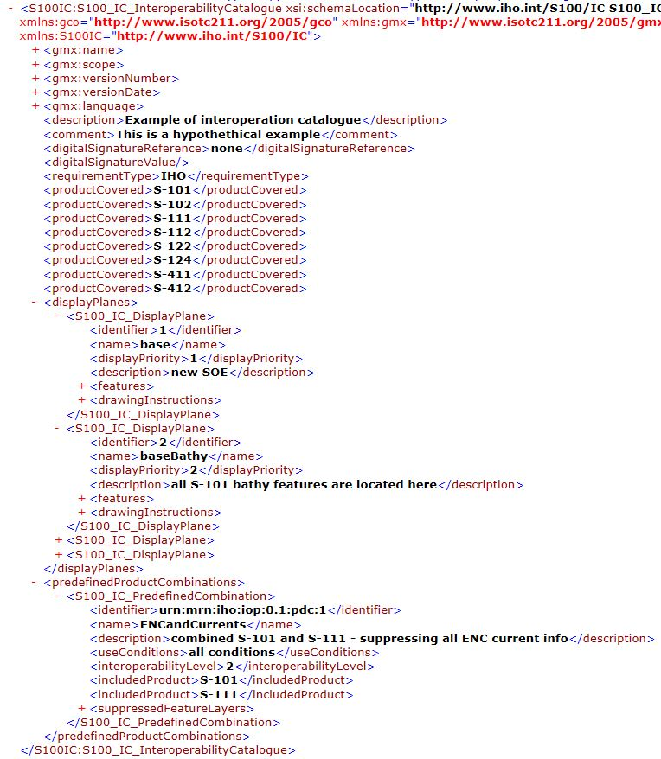
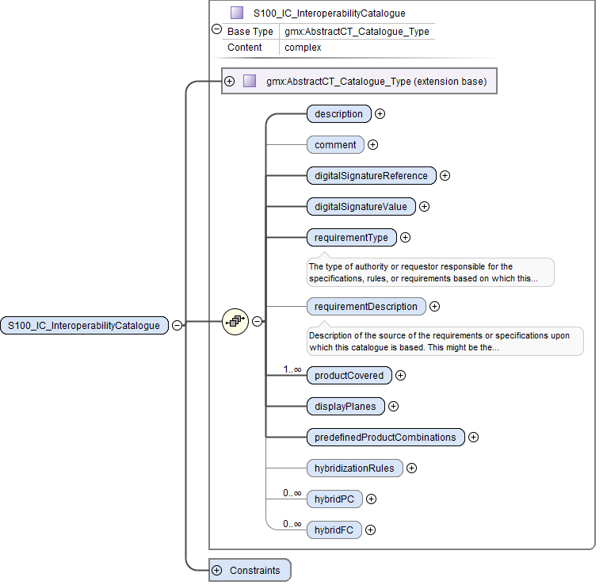
Data Product format (encoding)
Interoperability catalogues are in XML and uses UTF-8 character set.
Basic structure of an interoperability catalogue

Slide 41
DATA PRODUCT DELIVERY
Exchange Set Structure for base catalogue set
Exchange Set Structure for update catalogue set

Slide 42
DATA PRODUCT DELIVERY
The interoperability catalogue may be substituted by equivalent catalogues or presentations developed by manufacturers or service providers, provided the minimum functions are maintained and the producer of the replacement interoperability catalogue can prove this through testing.
The interoperation catalogue will be extensible with equivalent rules or presentations developed by manufacturers or service providers, provided the minimum functions are maintained and the producer of the augmented interoperability catalogue can prove this through testing.
OEM or service providers can provide their own versions in addition to the IHO catalogue, to facilitate custom product interoperations. These additional versions must not degrade or interfere with the functions of the official IHO Interoperability Catalogue.

Slide 43
Metadata
Fairly close to S-100 metadata.
S100_IC_CatalogueMetadata added as an extension from S100_DatasetDiscoveryMetadata in order to add the S100_ProductSpecification attribute.
This extension was done to try to avoid the need for a new specification should new products be added.
dataProduct code list is an open enumeration that permit new codes to be added without changing data model.
S100_CatalogueScope was also extended to permit the interoperabilityCatalogue value.

Slide 44

Processing model
Processing model was adopted as proposed in Phase 2. Giving both pre-processing and post-processing options.

Slide 45

Stages of processing model
This diagram shows the processing model when drawing instructions are generated before interoperability processing.
The alternative has similar stages in a different order.

Slide 46
Processing model
Stage | Description | Level | IC information | Context information | Remarks
Select Load Sets | Select data products to be loaded | All | included product list from S100_IC_‌Predefined‌Combination.‌included‌Product | S100_IC_PDCSelection identifies the S100_IC_‌Predefined‌Combination | -
Portrayal Processing | Ordinary S-100 portrayal processing | All | hybrid PC, display planes |  | Except final display processing / rendering
Interleave Feature Layers | Assign display plane and drawing order to feature data | 1, 2 | S100_IC_DisplayPlane
Suppress Feature Types | Suppress all instances of a specified feature type in a product | 2 | S100_IC_Suppressed‌Feature‌Layer
Rendering | Display processing | All | S100_IC_DisplayPlane

Slide 47
User interaction constraints and expectations
Interoperation is expected to be part of a future S-mode.
S-100 compatible ECDIS systems that support the IHO Interoperability Catalogue may include functionality that allow end users to add new predefined combinations according with their needs.
Implementers of this standard should follow the Human-Centred Design noted in MSC.1/Circ.1512.
The system should allow the user to change the interoperation level and/or pick a predefined combination by means of simple operations.

Slide 48
Data Encoding Guide
Included to provide encoding guidance on syntax, content, and catalogue structure for interoperability catalogue developers.
Includes general encoding notes on identifiers, feature codes, unknown attribute values, etc.
Expected to grow with further experience with Interoperability Catalogues.

Slide 49
Normative Implementation Guidance
Gives rules that implementers should follow when implementing the specification and providing interoperability support in their systems.
Includes rules for reducing demand on user attention in items like display adjustment, avoid text overload, system use modes and support for novice users.
Expected to grow with further experience with Interoperability Catalogues.
Moreover it states that “inclusion in interoperability catalogues of data products whose interoperability has not been discussed with product specification development team is recommended against”.

Slide 50
Change requests as outcomes of the Interoperability Workshop
4.6.3: Correct references to filtering by attribute values in Level 2.
17: Add section clarifying that interoperability actions and rules apply only where the data coverages of the products being operated on do have coverage.
4.4.2.4: The example needs to be replaced or corrected to remove the filter by attribute value part.
Structural change: 2 alternatives:
Move selection of features to suppress by attribute value filters to Level 2 from Level 3. Retain hybridizaton in Level 3. If this is done the changes above to 4.6.3 and 4.4.2.4 should be re-evaluated.
Make 5 levels by inserting a level between current levels 2 and 3 and making selection by attribute values a part of that.
S-101 should consider having display priority steps of 10 to give more room for interleaving new products with ENC.

